Slide 1

Will They Claim It ??
Team – Runtime Terror

Slide 2
Problem Statement:
As a Travel Insurance organisation, it is very important to analyse each and every customer in order to minimize the risk of unnecessary claim approval and also to see that genuine claims are not rejected so as to avoid law-suits which might the organisation need to face in future.
Also, forecasting the upcoming claims helps to charge competitive premiums that are not too high and not too low. It also contributes to the improvement of the pricing models. This helps the company to be one step ahead of its competitors.
Stake Holder – Chief Planning Officer

Slide 3
Table of Contents:
EDA & Visualization
Feature Engineering
Feature Selection
Model Building
Conclusion

Slide 4
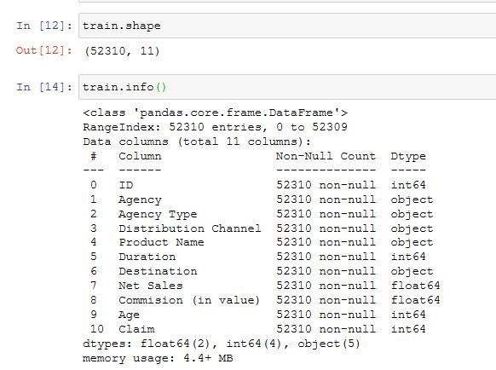
EDA & Visualization
What is the strength of the dataset?
Inference :
From a given dataset we could see there are total 52310 cases and 11 Features.

Slide 5
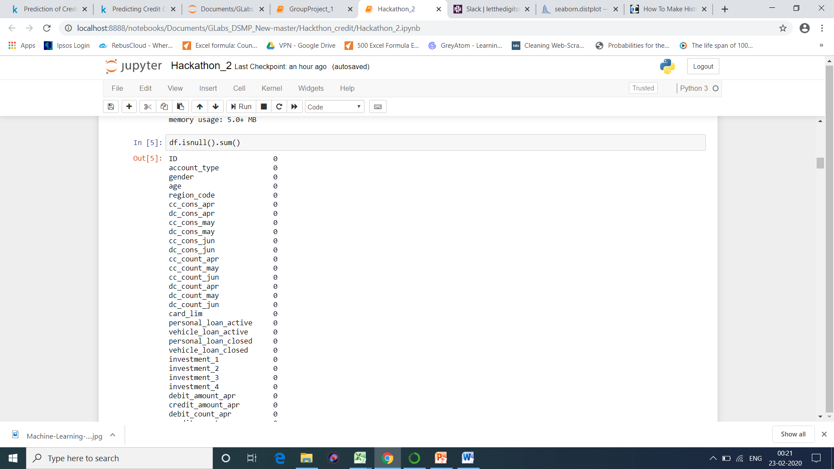
Are there any data discrepancies? If they are what should be our approach to handle them?
Readings: We observed that there were no Null values.
What kind of data Science problem is this?
Readings: We can see target variable “Claim“ given in dataset hence this comes under Supervised Machine learning !!!!!!
How many object and numeric features are there?
Readings: We observe that except Duration, Net Sales, Commission (in value) and Age rest of them are of Categorical types. We have also observed that our target labels “Claim“ is of Categorical type hence this problem statement comes under Classification Problem.

Slide 6
Are there any feature which are not making sense and we can remove the same from dataset?
Readings: Post going through the entire data, we concluded that few of the feature are not going to help us in analysis and we can remove them.

Slide 7
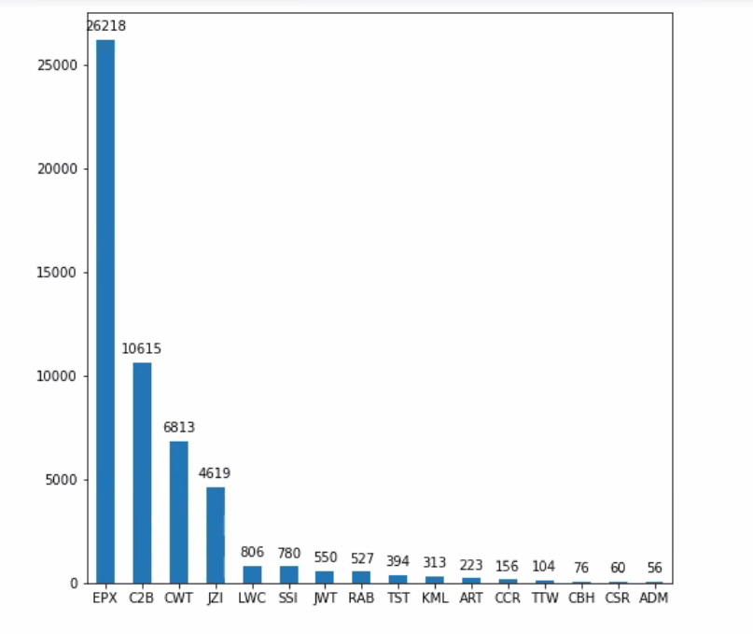
How many insurance policies were sold by each agency ?
Inference :
From above graph, we can conclude that EPX is selling most of the policies,
while ADM is lowest in selling the policies

Slide 8
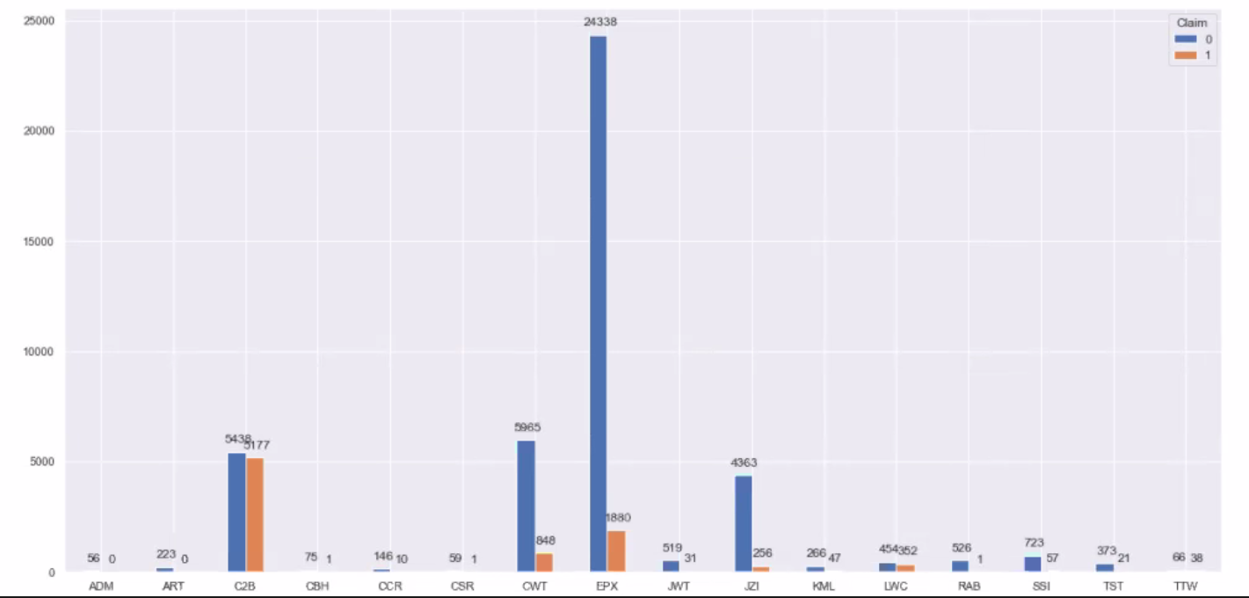
Claim analysis with respect to agency
Inference :
From above graph, we observed the claim data with respect to each agency.

Slide 9
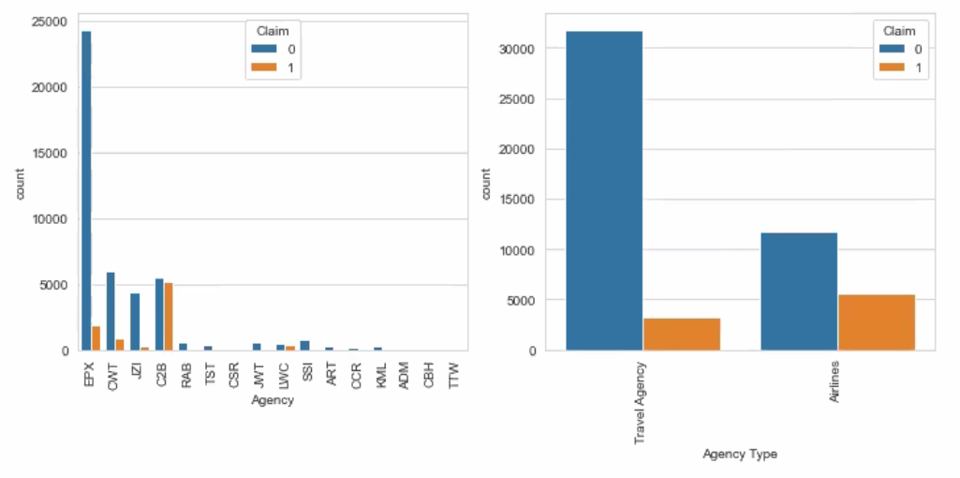
“Agency” & “Agency Type” wise “Claim Rate” & “Mean Commission”
Inference :
Claim rate of particular agency and the line plot is for their average commission (Left graph)
Also , The Target variable is highly imbalanced. Not Claimed (Class 0) is dominating
over Claimed(Class 1). Not Claimed is 83.33% and Claimed is 16.66%. (Right graph)

Slide 10
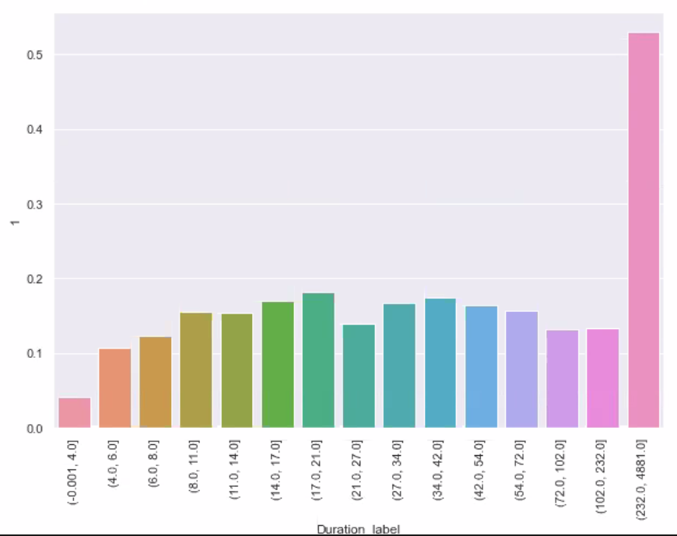
Duration impact on claim rate
Inference :
From above graph, we observed that which duration group is claimed maximum time

Slide 11
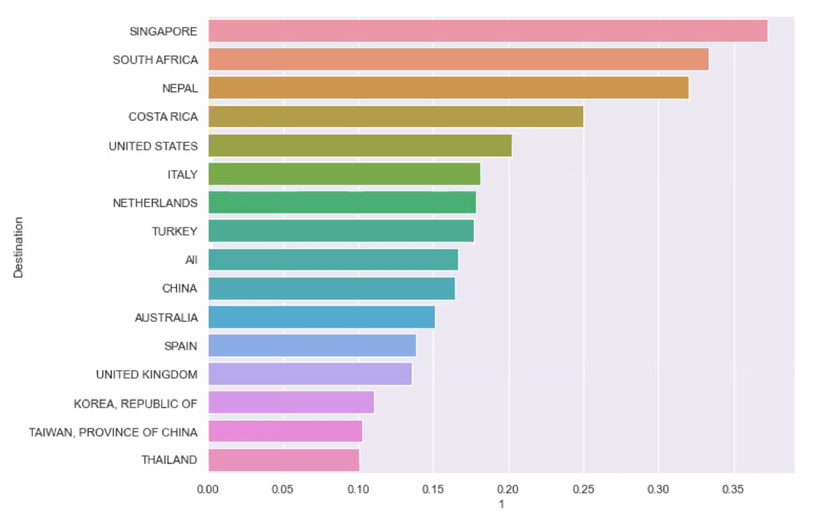
Impact of Destination on Claim rate
Inference :
From above graph, we observed that, Person visiting to Singapore is Claiming maximum time
which is around (38%)

Slide 12
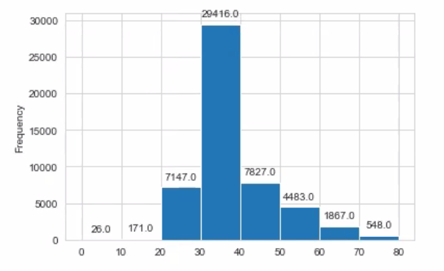
Age spread in sample
Inference
We can clearly observe that most of the customers lies in the Range of
25 to 55 years. One graph need to be added

Slide 13
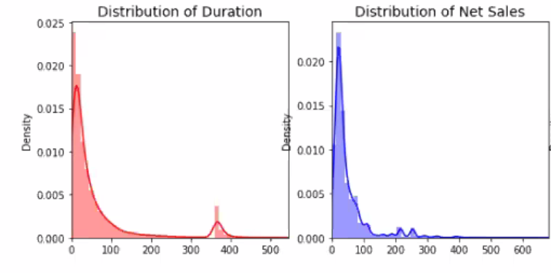
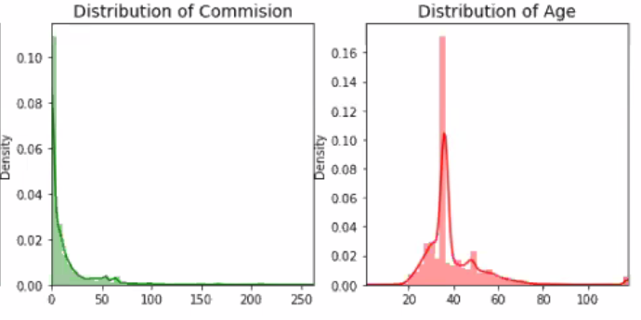
Distribution of “Duration", "Net Sales”,”Commission”,”Age”

Slide 14
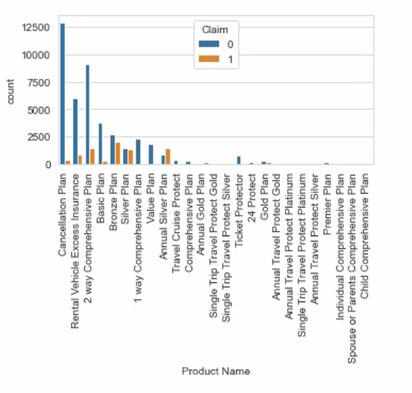
Product wise impact on Claim
Inference :
Here, from this graph we can
observe that “Bronze Plan”,
”Annual Silver Plan", "Silver Plan”
is Claimed most.
Similarly, “Cancellation Plan”,
”2 Way Comprehensive Plan”,
“Rental Vehicle Excess Insurance” is
Most amongst Not Claimed.

Slide 15
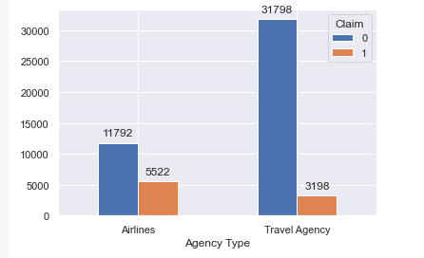
Distribution of Claim across Agency Type?

Slide 16
Inference:
There are 43,590 observations (83.33%) for 'Not Claimed' insurances and only 8,720 (16.66%) 'Claimed' insurances. The data set is quite imbalanced.
Most insurances are issued by Travel Agencies(66.90%) and the rest by Airlines.
Critical: 31.89% of insurances issued by Airlines are claimed whereas only 9.14% of insurances issued by Travel Agencies are claimed.
Insight: Claimed Insurances for Airlines is very high. The company should change the threshold of insurances sold by Airlines.

Slide 17
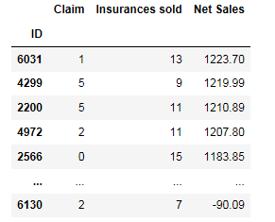
Insights for the 'ID' column

Slide 18
Inference:
From the plot above, these are top 5 customers who issued travel insurance from Safe Travel Inc multiple times and generated maximum sales for the company.
Insight:
Vouchers can be given to customers who give maximum sales to the company and not randomly. -marketing team, sales team

Slide 19
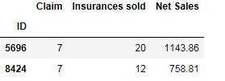
Observations for ID Column
Inference:
There are only 7992 unique customers who have bought multiple insurances.
More than 50% customers in the data set have bought insurances between 5 to 8 times. Most customers have returned to buy travel insurances.
66.14%(5286) of customers have claimed their insurances at least once. 2706 customers (33.85%) were never claimed.
2 Customers (ID- 5696 & 8424) have claimed their insurance 7 times.
Insight: 83% of insurances issued are not claimed yet almost 66% customers get their claimed money. Simply from the data, most customers find it suitable to issue an insurance and hence come back several times but we don't know if the company is able to keep its profit margins.

Slide 20
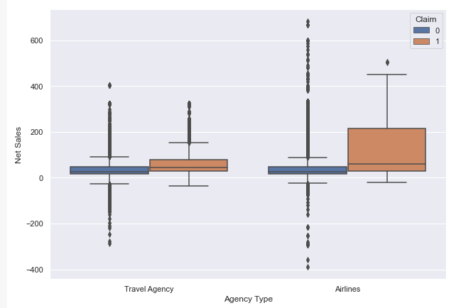
Columns- Agency, Agency Type, Product Name, Net Sales
From the data, 4,486
Insurances (31.24%) are claimed
out of 14,358 insurances with
Net Sales above 50 .
Whereas, only 4,234
insurances (11.15%) are claimed
out of 37,952 insurances with
Net Sales below 50.
Insurances with higher 'Net Sales' are claimed more often than with lower Net Sales.
Though the total net sales from airlines & travel agencies are almost same because airlines
are selling more expensive insurances, that is also the reason airlines has more insurances
being claimed

Slide 21
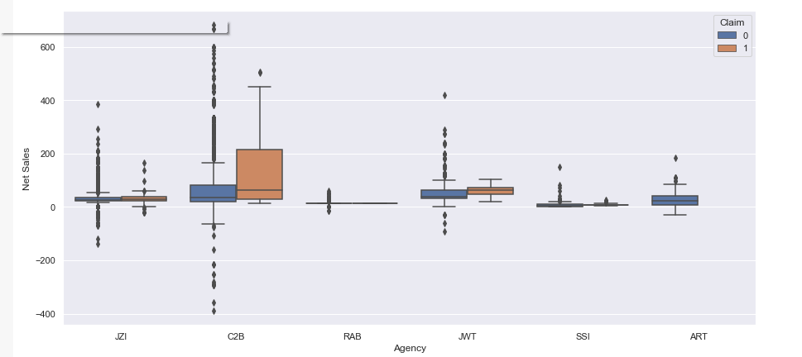
Distribution of net sales across all agencies of Airlines.

Slide 22
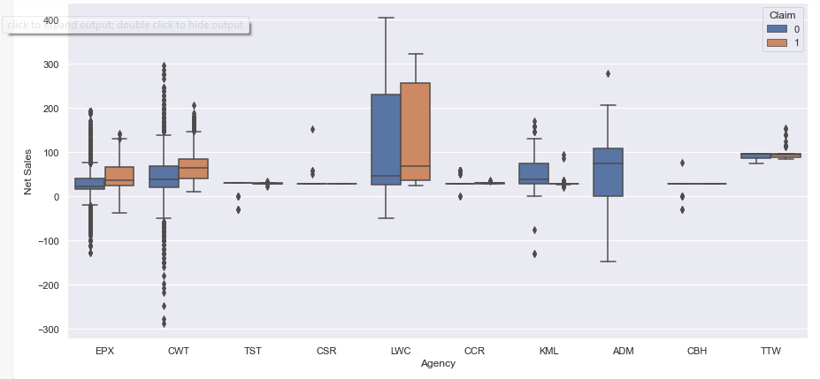
Distribution of net sales across all agencies of Travel Agencies.
Inference:
The observation also fits well with how agencies sell insurances. Agencies such as C2B, LWC, EPX and CWT have more claimed insurances because they sell insurances for more Net sales.

Slide 23
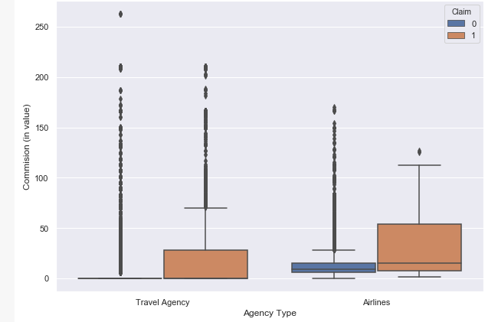
How Commission effects the claim on The Basis of Agencies

Slide 24
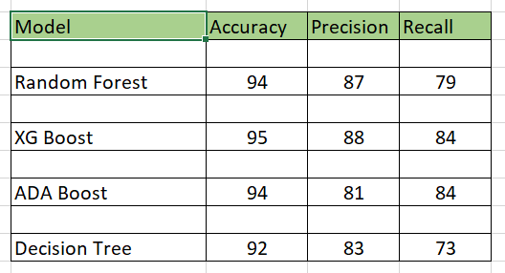
Model Performances
Best Model :
XG Boost was best , based on precision score

Slide 25
Conclusion
Bronze Plan, Silver Plan and Annual Silver Plan needs modifications in the product
features due to higher commission to sales roll outs and claim rates.
Average age of personas travelling is 40 years.
Destination wise, persons travelling to Singapore, South Africa and Nepal are claiming most.
In Products, 'Annual Gold Plan‘ , 'Annual Travel Protect Gold‘ , 'Annual Silver Plan' and
'Single Trip Travel Protect Platinum' have Higher claim Percentage

Slide 26
Thank You
Team :
Prashant Yadav
Abhishek Bhoite
Manisha Kalita
Rohit gawande

